Slide 1
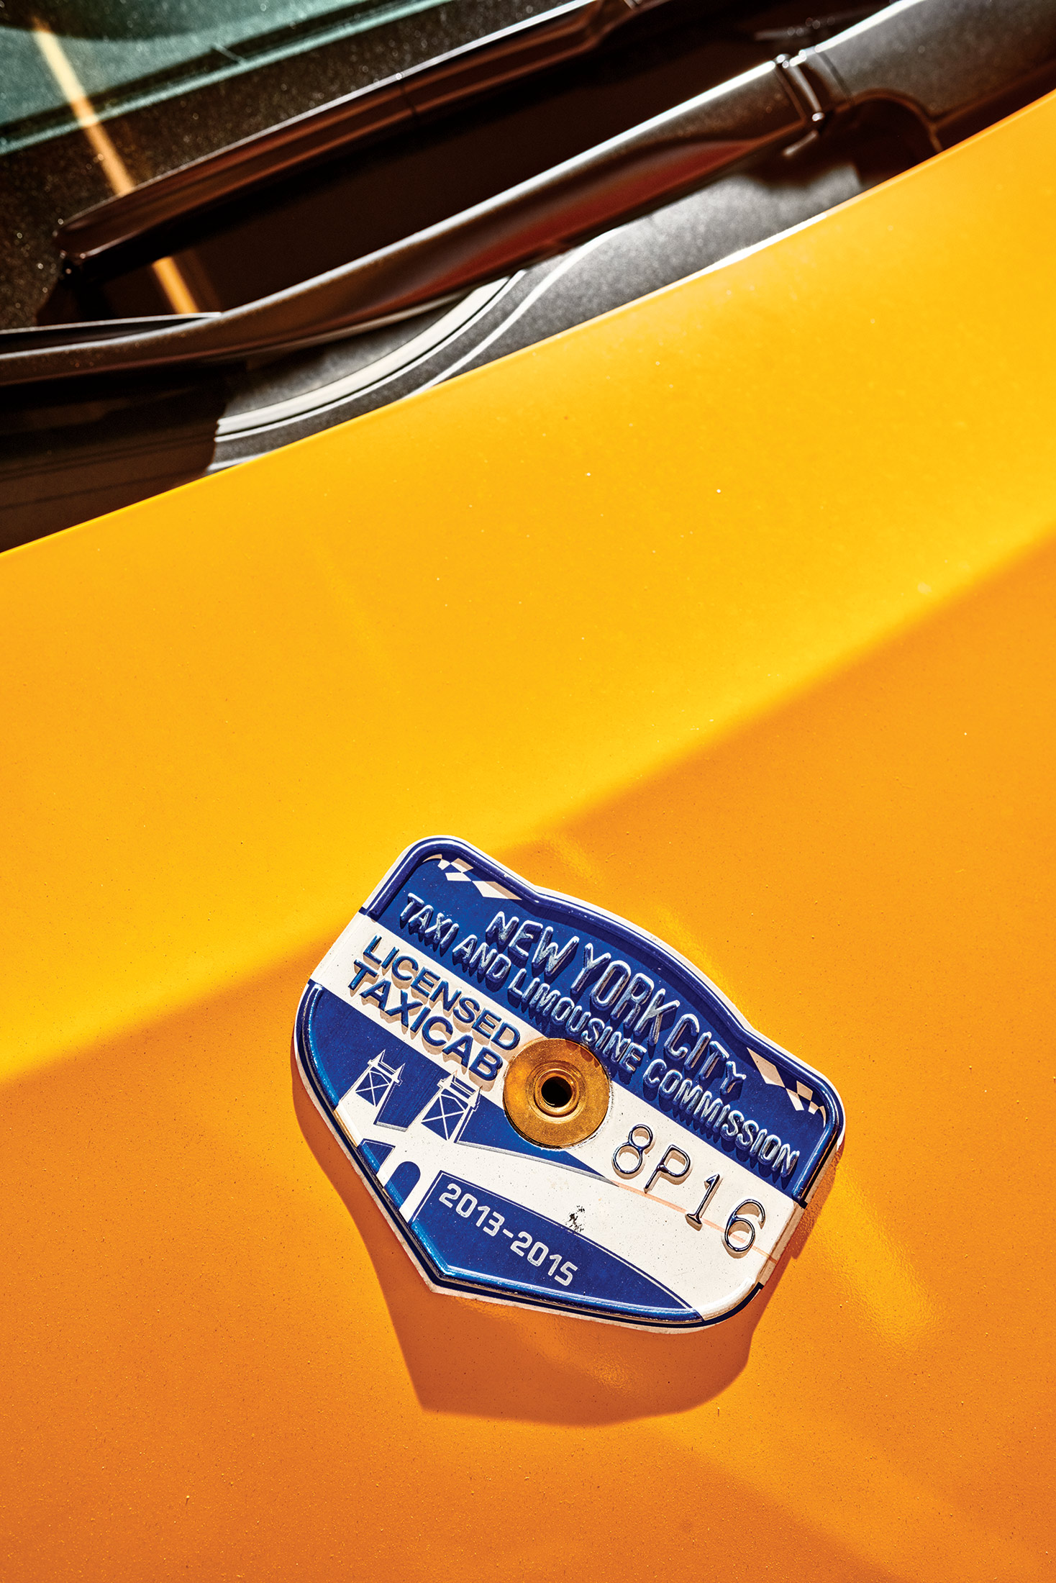
NYC Taxi Data Abhishek Das

Slide 2
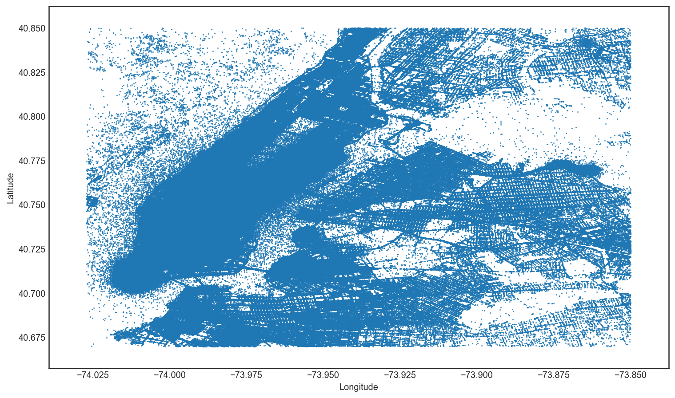
One Month
2 companies
13,276 taxis
34 million miles
$184 million in revenue

Slide 3
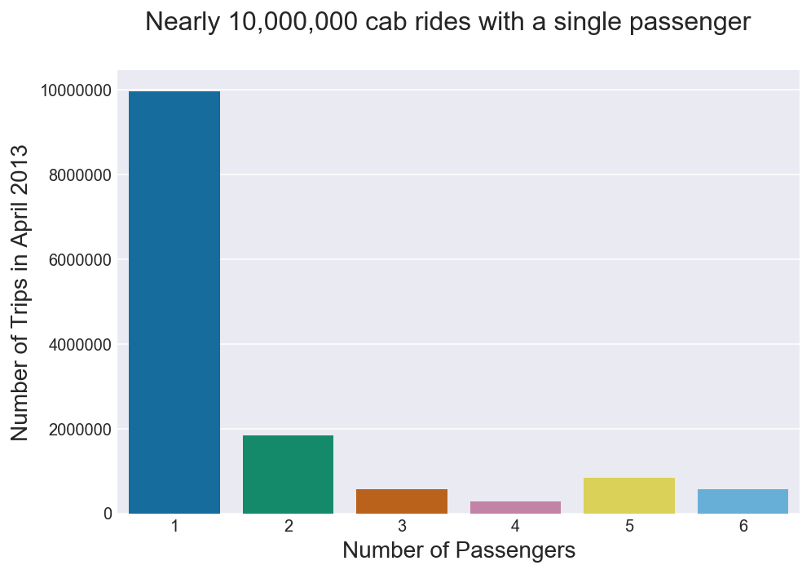
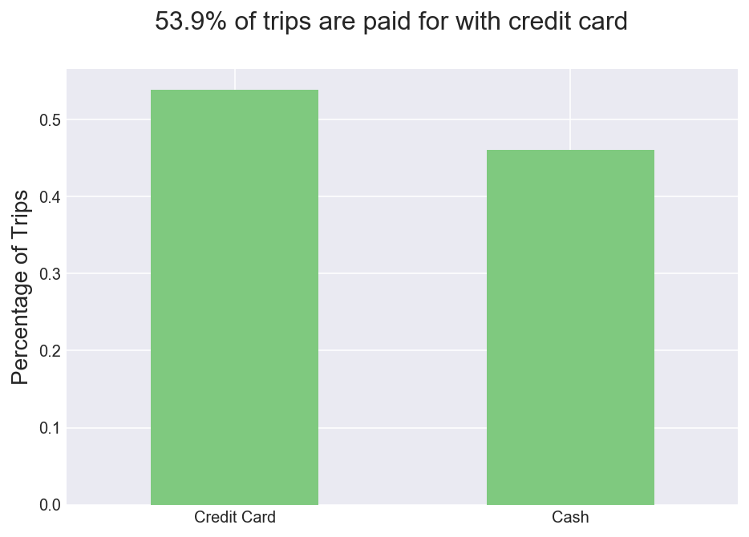
Passengers

Slide 4
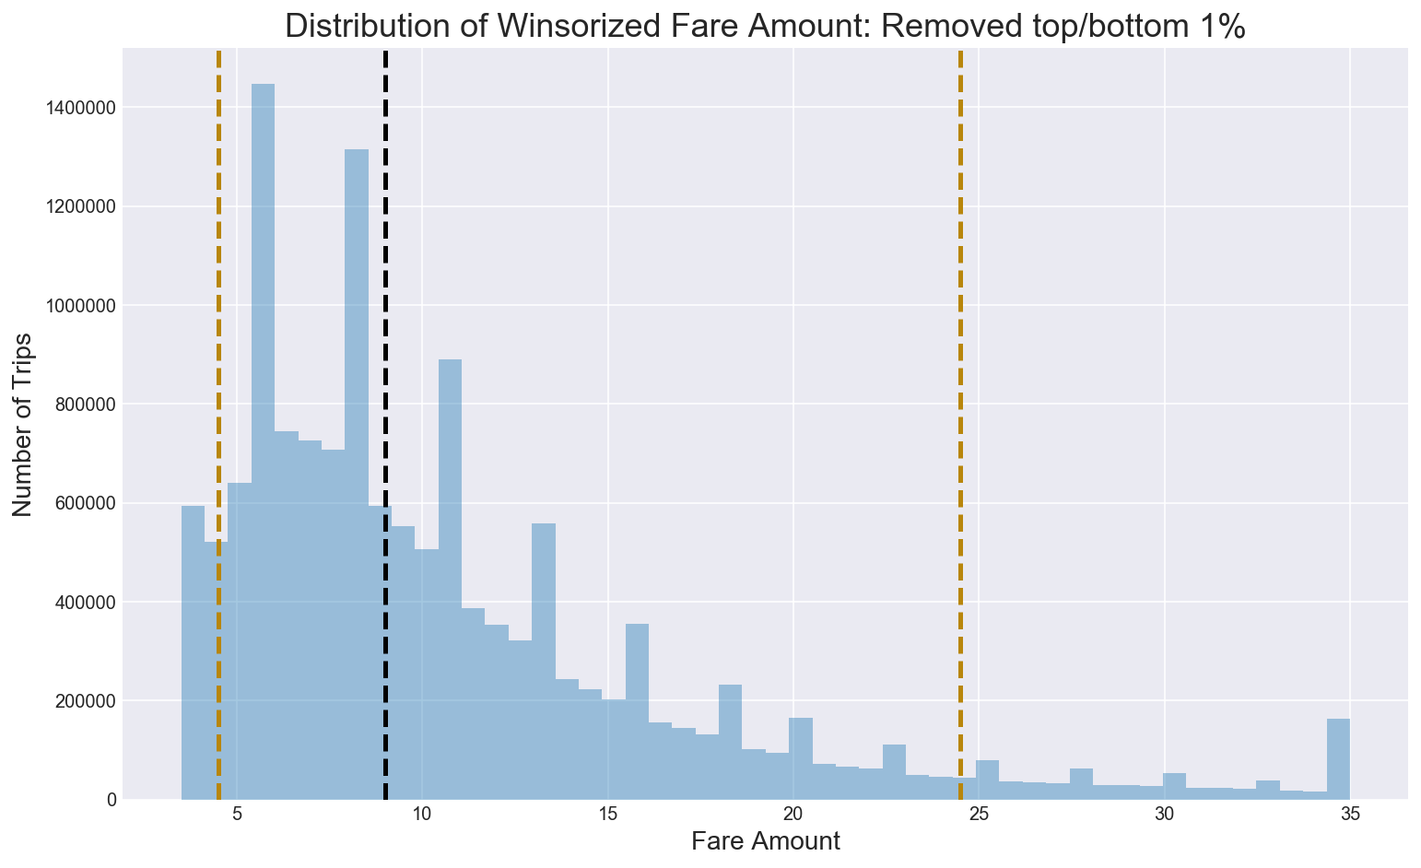
Most fares are under $35

Slide 5
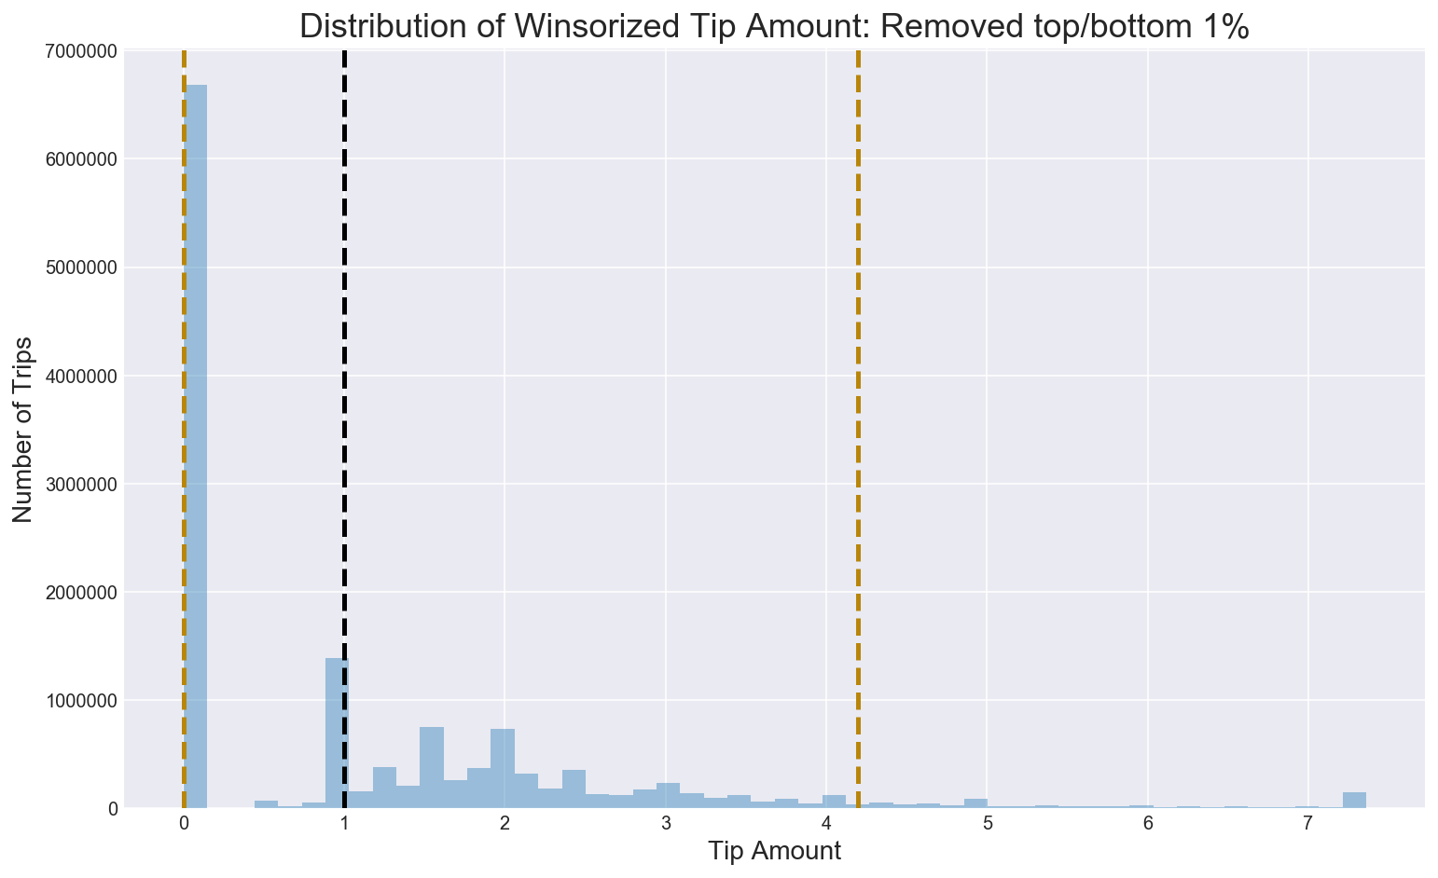
Low tips reported

Slide 6
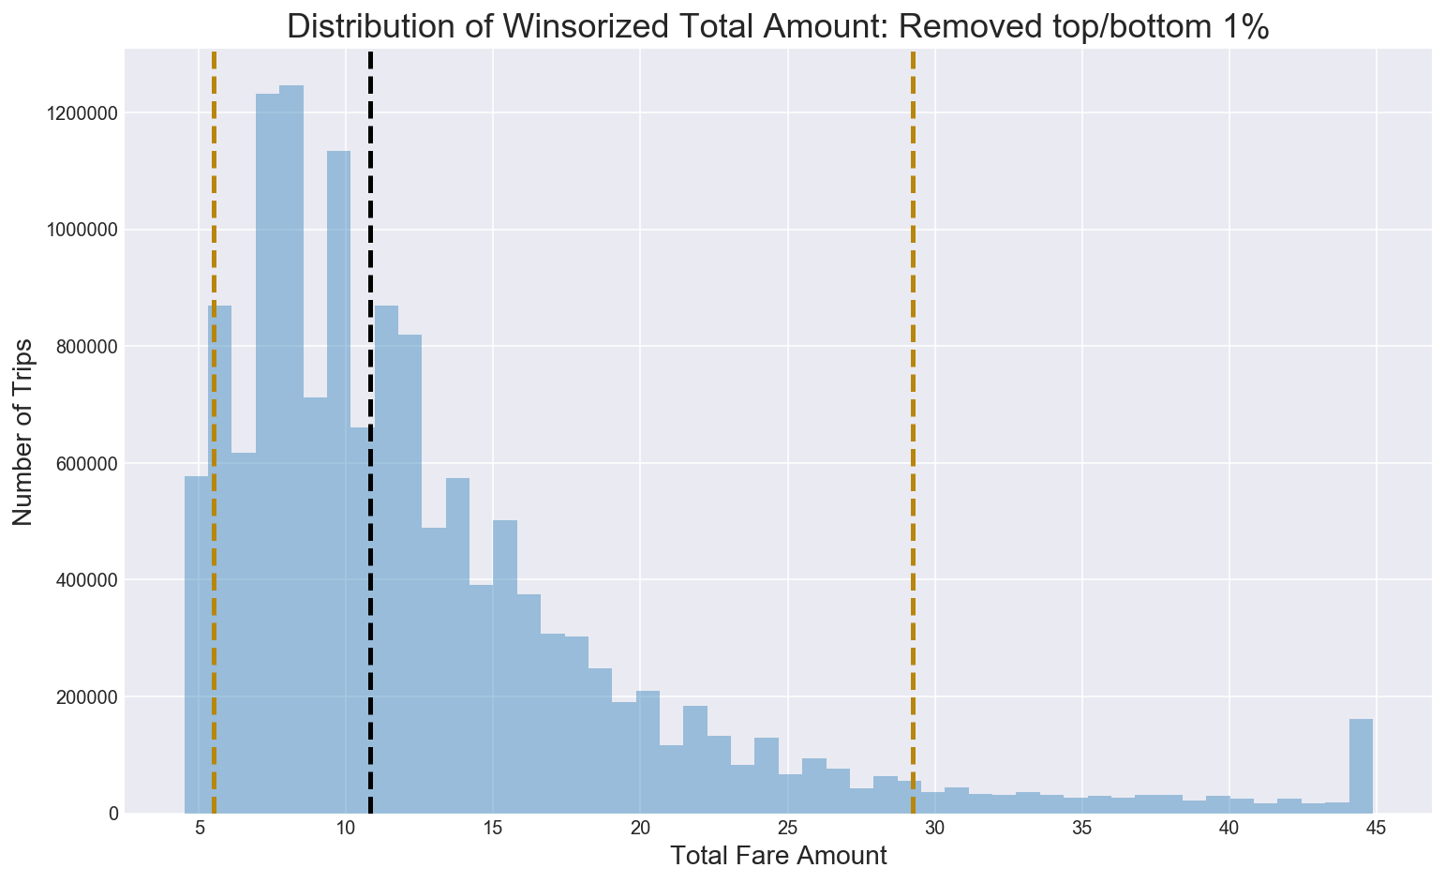
Total Amount below $45

Slide 7
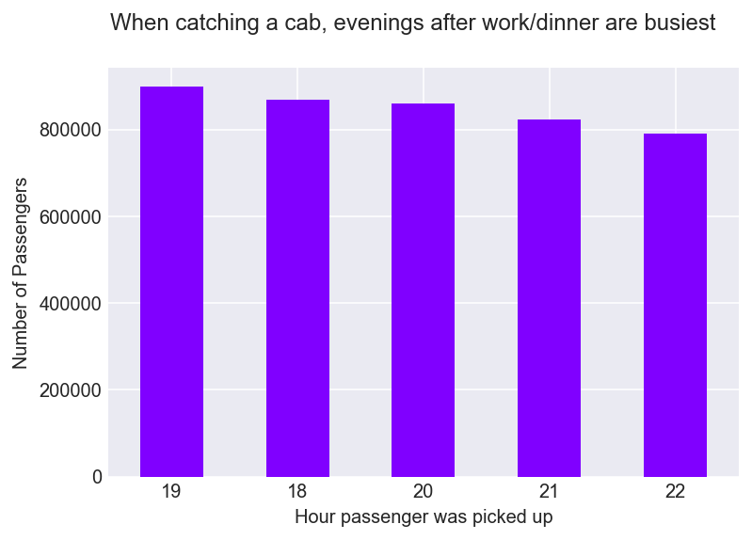
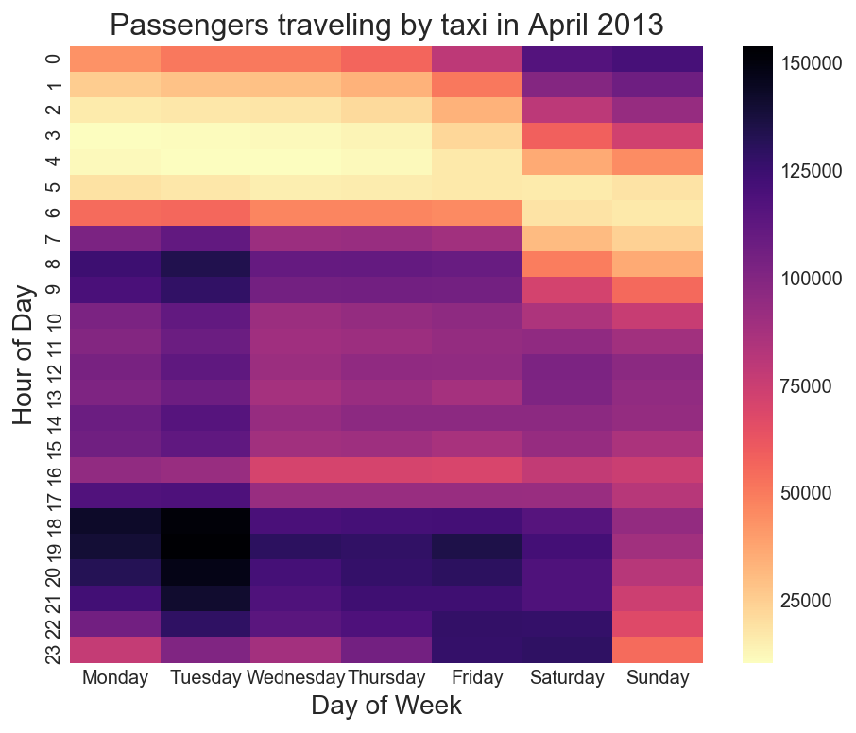
Mon, Tue & weekend evenings are busiest

Slide 8
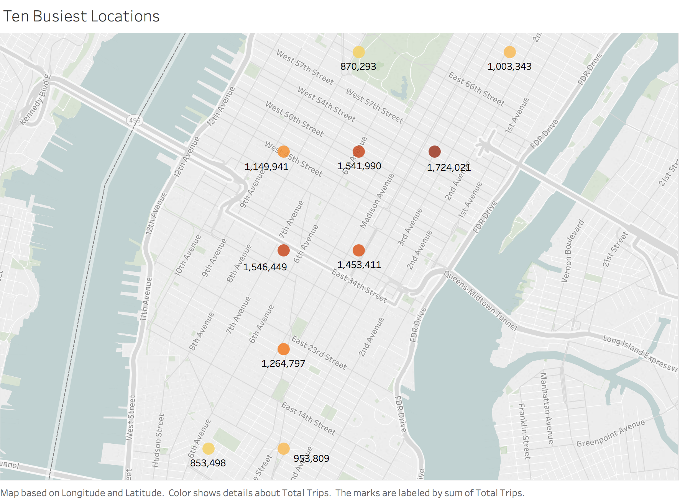
12.36m trips in Manhattan
Notes:
Most populous of New York’s five boroughs

Slide 9
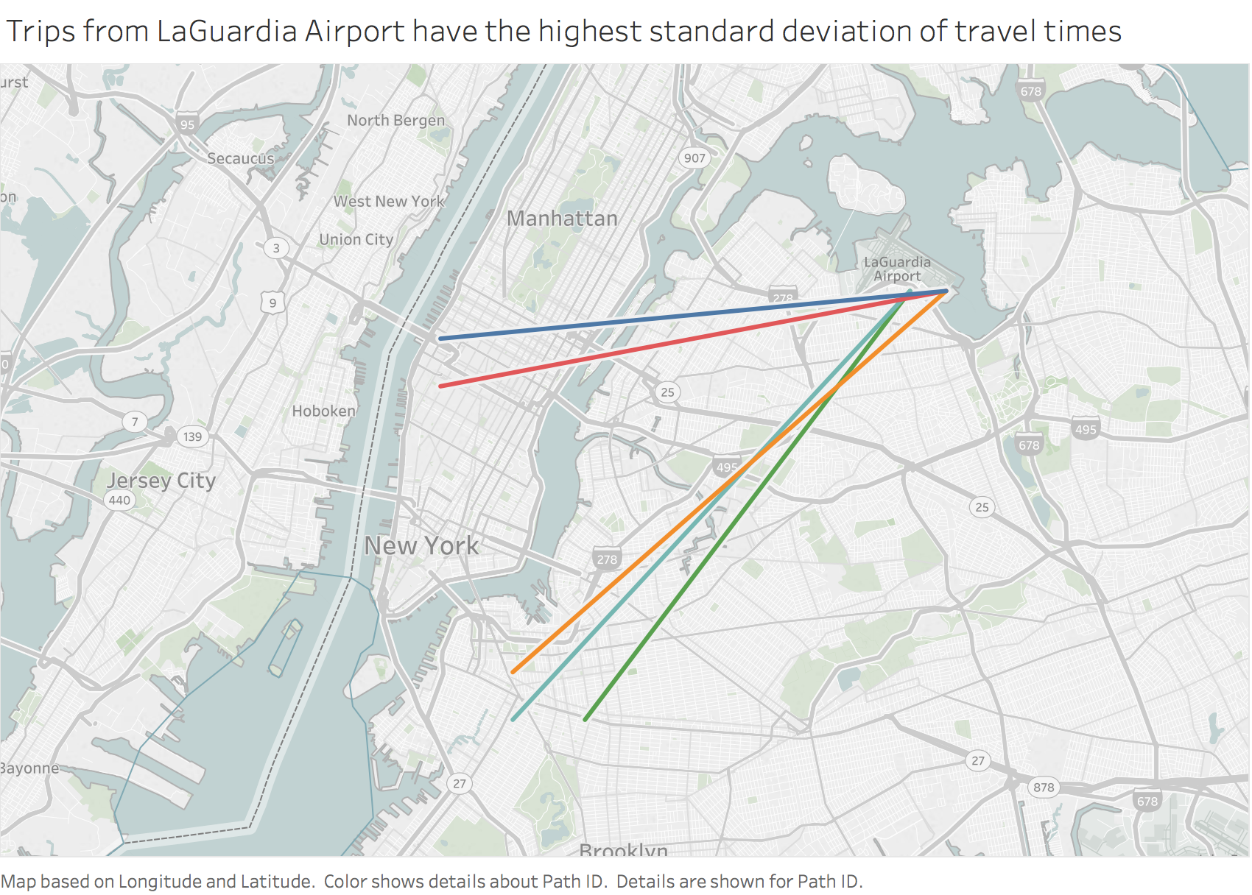
Airport travel times fluctuate

Slide 10
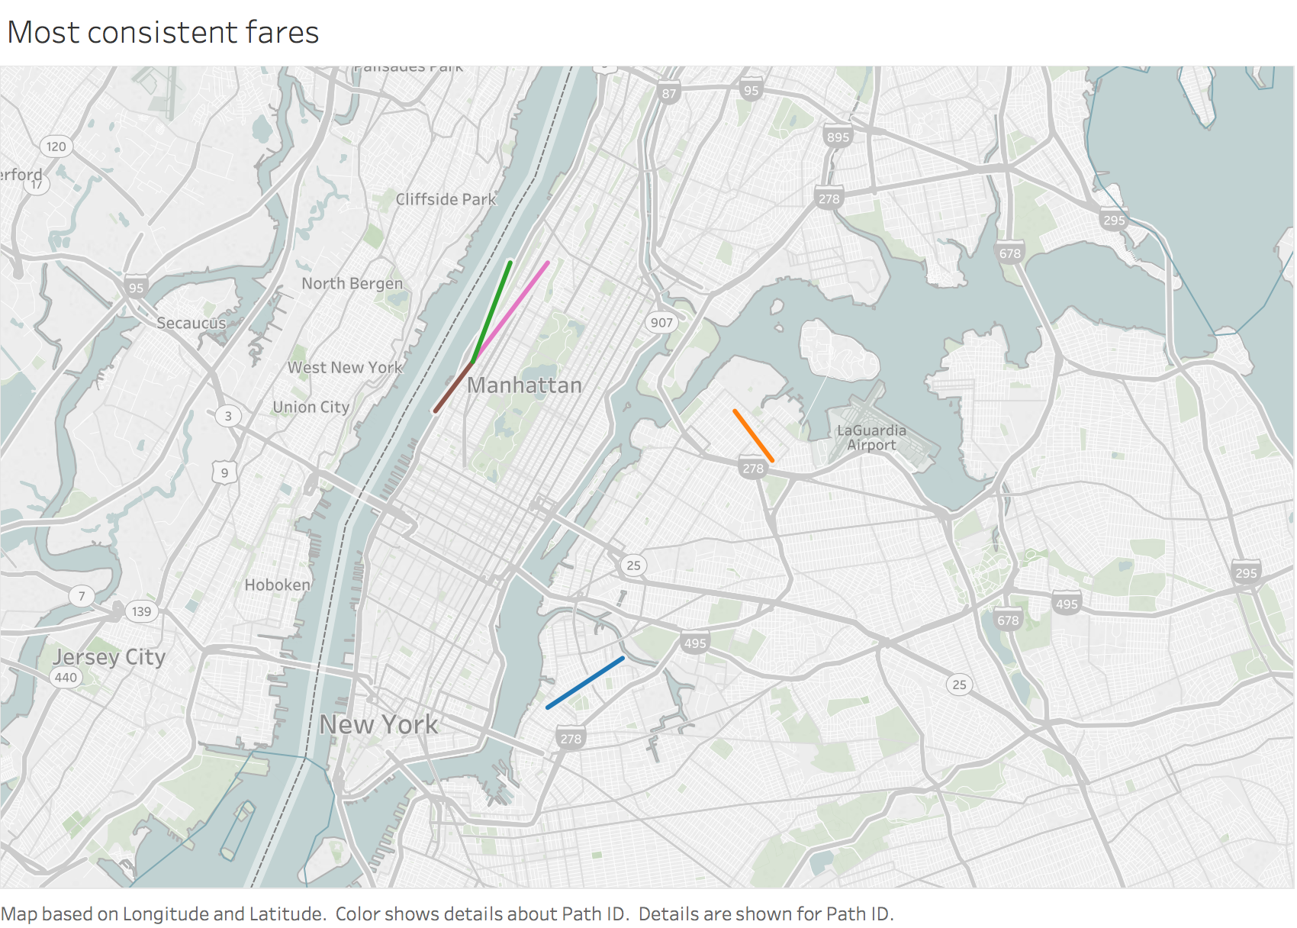
Shorter fares reliable

Slide 11
Minimum Sample Size
Margin of Error = 5%
Confidence Interval = 95% -> Z-Score = 1.96
Standard Deviation = 50%
Sample Size = (1.96*0.5/0.05)^2 = 385 trips

Slide 12
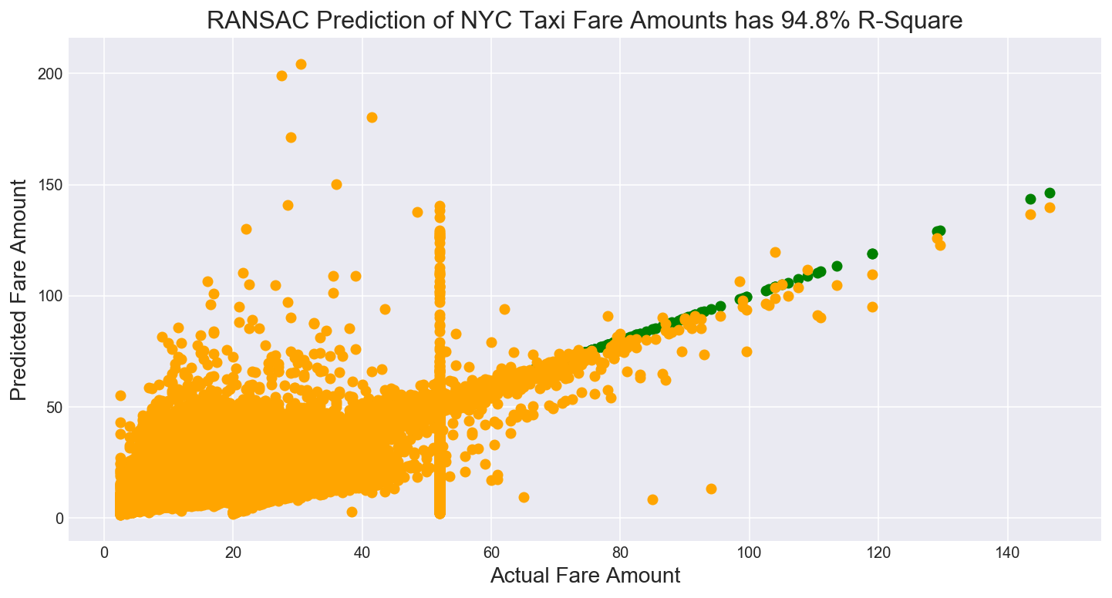
Predicting Taxi Fares

Slide 13
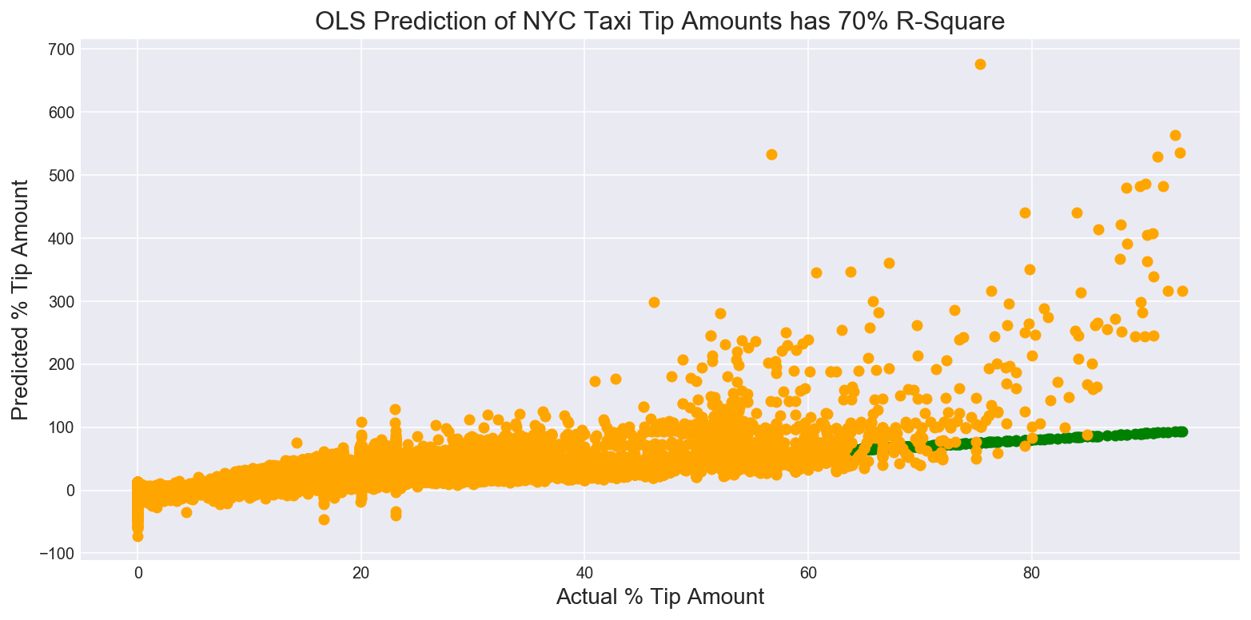
Predicting % Tip

Slide 14
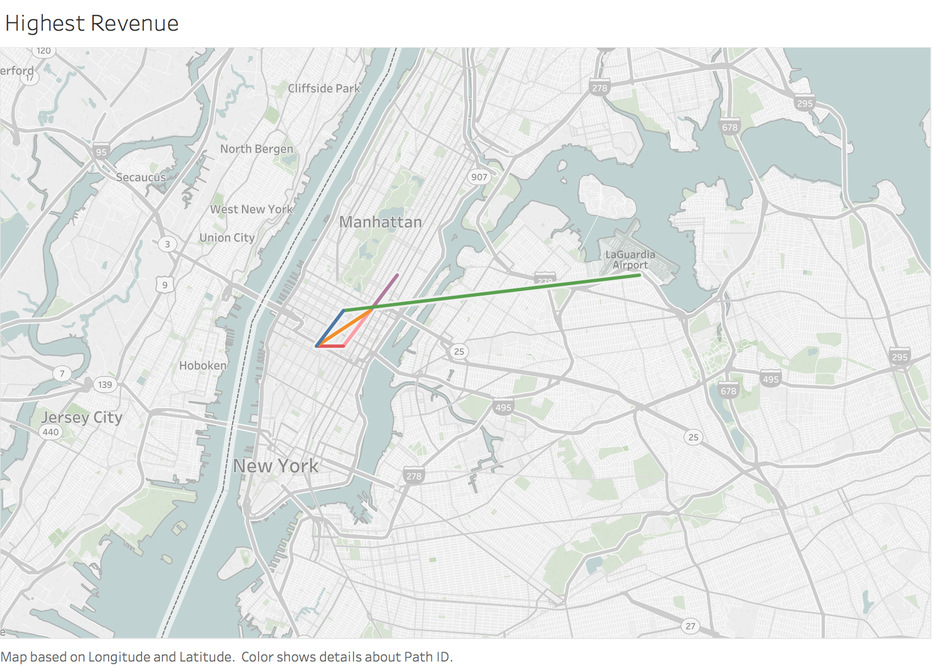
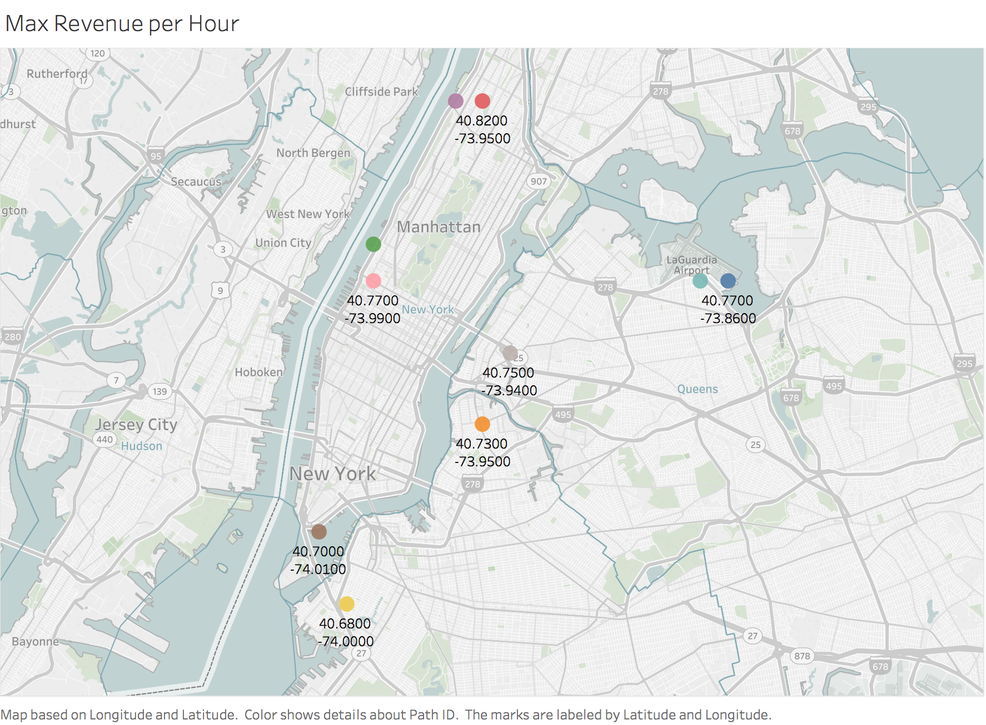
Maximize Daily Earnings

Slide 15
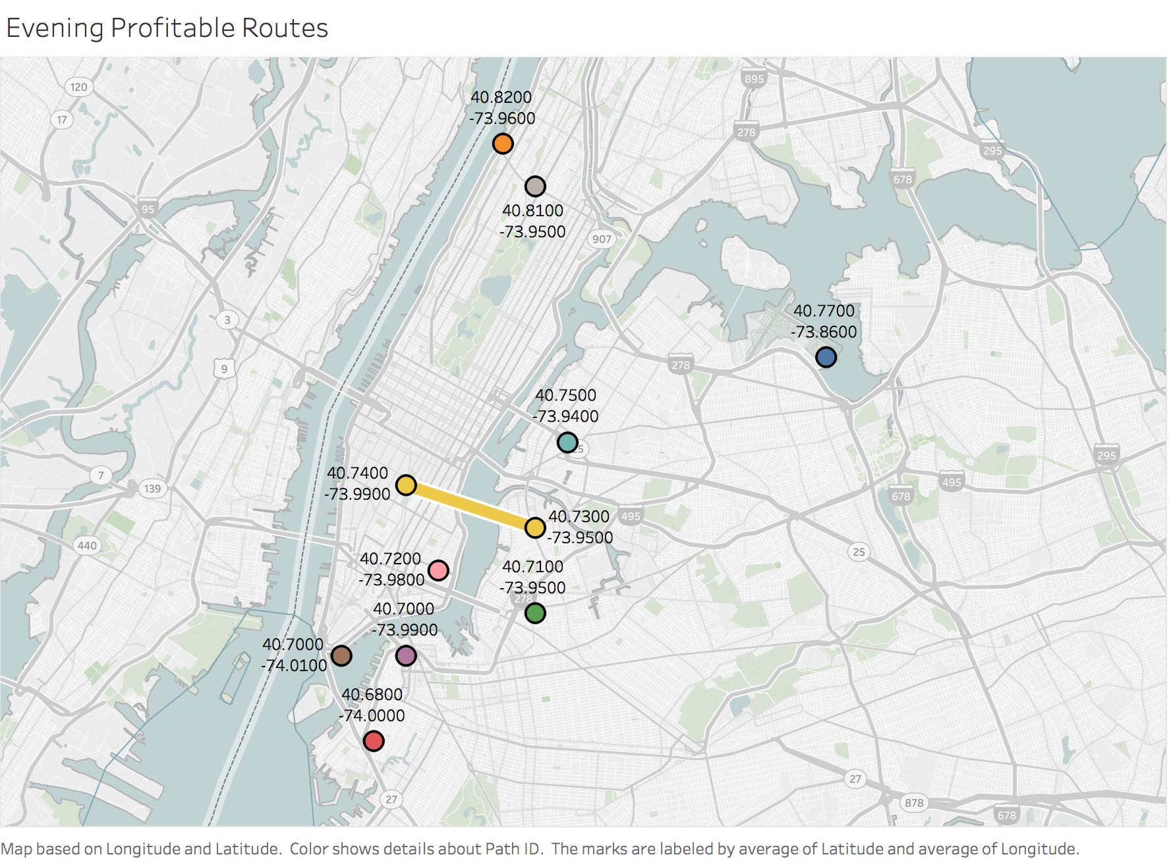
Profitable Evening Routes

Slide 16
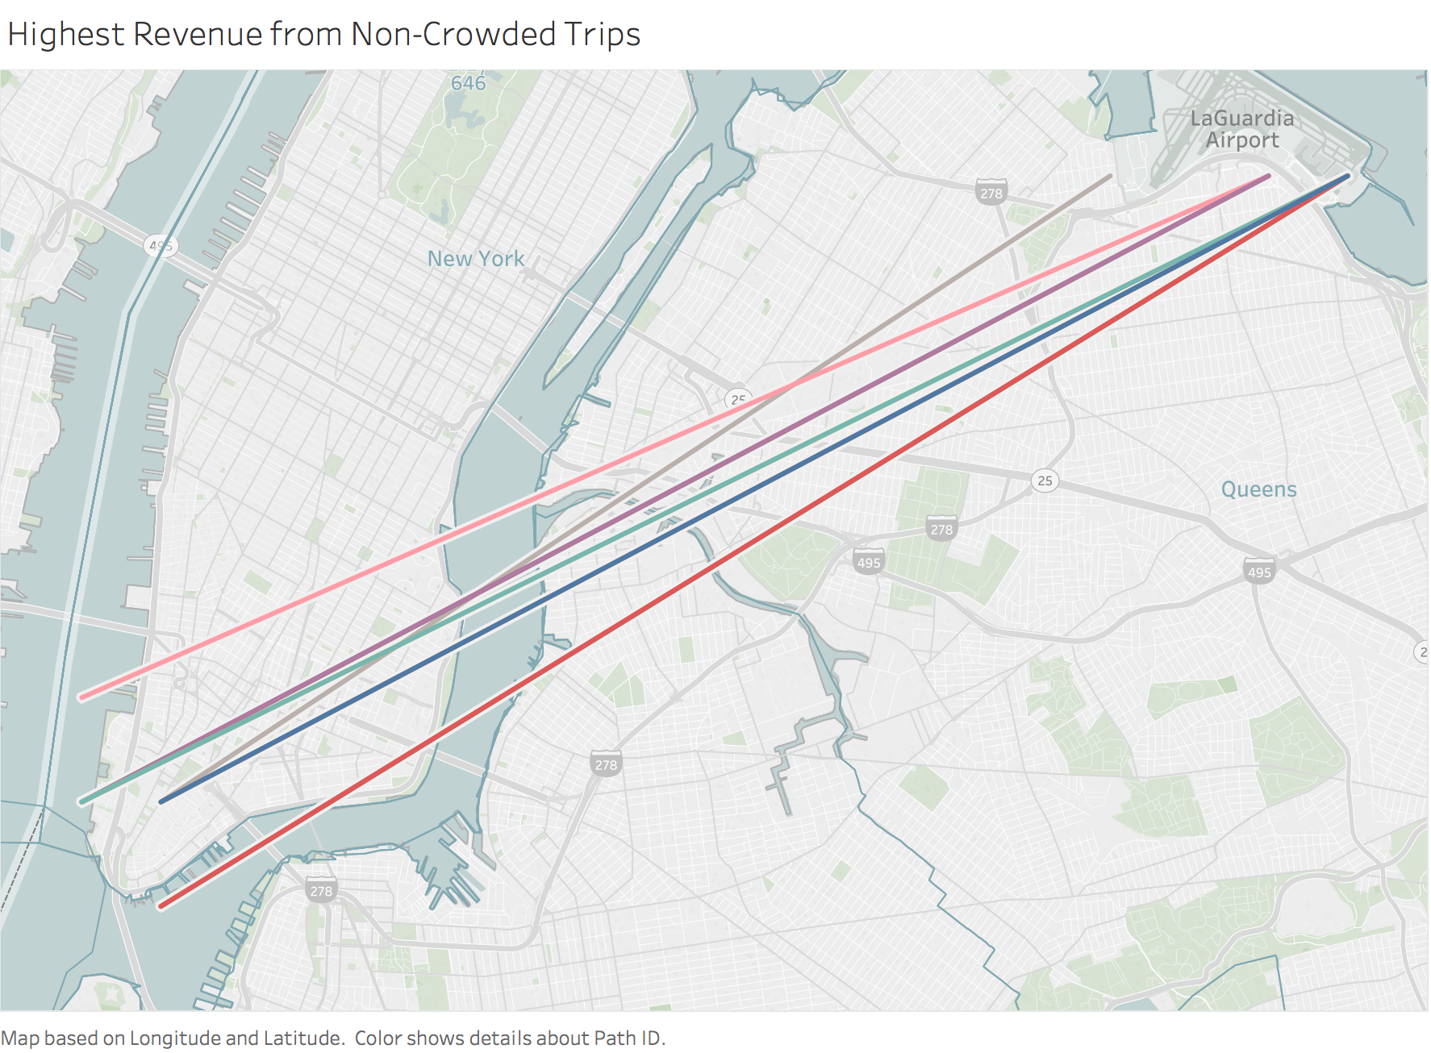
Non-Crowded Trips

